Slide 1
Assembly Basics
Zhen Huang
DePaul University

Slide 2
Agenda
Intel x86 Processors
Assembly Instruction Syntax
Generic Registers
Example Assembly Instructions
Moving Data
Simple Memory Addressing Mode
Exercise

Slide 3
Intel x86 Processors
Dominate laptop/desktop/server market
Evolutionary design
Backwards compatible up until 8086, introduced in 1978
Added more features as time went on
Model | Release Date | # Transistors | Frequency (MHZ)
8086 | 1978 | 29K | 5-10
80386 (IA32) | 1985 | 275K | 16-33
Pentium 4E (x86-64) | 2004 | 125M | 2800-3800
Core i7 | 2008 | 731M | 1700-3900

Slide 4
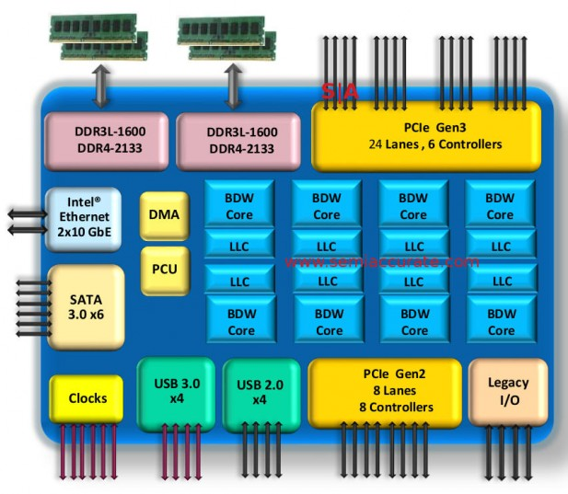
2015 State of the Art
Core i7 Broadwell 2015
Desktop Model
4 cores
Integrated graphics
3.3-3.8 GHz
65W
Server Model
8 cores
Integrated I/O
2-2.6 GHz
45W

Slide 5
x86-64
16 generic 64-bit integer registers
rax, rbx, rcx, …., r8, r9, r10, … r15
Large number of instructions
Move data: mov
Compute memory address: lea
Procedure call: call/ret
Branching: jmp/jnz/jz/jp/jnp/jo/jno
Arithmetic/logical operations: add/sub/mul/div/and/or
Comparison: cmp/test
Various memory addressing modes
register: (%rbx)
register+offset: -4(%rbp)
register_{base}+register_{index}*scale+offset: 8(%rdx, %rcx, 2)
constant: 0x400700

Slide 6
Assembly Instruction Syntax
Linux uses AT&T Assembly Language Syntax
General form of instruction: mnemonic src, dest
mov %rax, %rbx
add %rax, %rbx
A mnemonic may include a suffix to specify the size of the operands
q – quad word 8 bytes, l – long word 4 bytes, w – word 2 bytes, b – byte
movl $0x11223344,-0x4(%rbp)
Register names starts with %
Immediate data (constant integer) starts with $
mov $1000, %esi

Slide 7
x86-64 Integer Registers
%rax
%r8
%eax
%r8d
%rbx
%r9
%ebx
%r9d
%rcx
%r10
%ecx
%r10d
%rdx
%r11
%edx
%r11d
%rsi
%r12
%esi
%r12d
%rdi
%r13
%edi
%r13d
%rsp
%r14
%esp
%r14d
%rbp
%r15
%ebp
%r15d
Can reference low-order 4 bytes (also low-order 1 & 2 bytes)

Slide 8
Assembly Instruction Example - mov
*dest = t;
s = t;
C Code
Assembly
%rbx represents dest
%rax represents t
%rdi represents s
movq %rax, (%rbx)
mov %rax, %rdi

Slide 9
Assembly Instruction Example – call/ret
long sub(long x, long y) {
return x – y;
}
int main() {
long t = sub(2000, 1000);
C Code
Assembly
A procedure name is a label
A procedure call passes arguments in registers, e.g. %rsi, %rdi
Return value passed back in %rax
sub:
....
retq
main:
....
mov $0x3e8, %esi
mov $0x7d0, %edi
call sub
mov %rax, -8(%rbp)

Slide 10
Assembly Instruction Example – arithmetic & logical
long t1 = x + y;
long t2 = t1 >> 3;
long t3 = z - t2;
long t4 = t3 << 3;
long t5 = t4 ^ z;
C Code
Assembly
add instruction adds source into dest
sub instruction subtracts source from dest
addq %rsi, %rdi
sarq $3, %rdi
movq %rdx, %rax
subq %rdi, %rax
salq $3, %rax
xorq %rdx, %rax

Slide 11
Moving Data
%rax
%rcx
%rdx
Moving Data
movq Source, Dest:
Operand Types
Immediate: Constant integer data
Example: $0x400, $-533
Like C constant, but prefixed with ‘$’
Encoded with 1, 2, or 4 bytes
Register: One of 16 integer registers
Example: %rax, %r13
But %rsp reserved for special use
Others have special uses for particular instructions
Memory: 8 consecutive bytes of memory at address given by register
Simplest example: (%rax)
Various other “address modes”
%rbx
%rsi
%rdi
%rsp
%rbp
%rN

Slide 12
Simple Memory Addressing Modes
Normal (R) Mem[Reg[R]]
Register R specifies memory address
Pointer dereferencing in C movq (%rcx),%rax
Displacement D(R) Mem[Reg[R]+D]
Register R specifies start of memory region
Constant displacement D specifies offset movq 8(%rbp),%rdx

Slide 13
Example of Simple Addressing Modes
void swap
(long *xp, long *yp)
{
long t0 = *xp;
long t1 = *yp;
*xp = t1;
*yp = t0;
}
swap:
movq (%rdi), %rax
movq (%rsi), %rdx
movq %rdx, (%rdi)
movq %rax, (%rsi)
ret

Slide 14
Exercise - 1
Explain what’s the effect of each instruction
mov $10, %rax
mov $5, %eax
movl $12345678, (%rbp)
mov (%rbx), %rcx
mov %rdi, -4(%rbp)
add %rcx, %rdx
salq $2, %rax
call decode
ret

Slide 15
Exercise - 2
What is the value of %rdi after running the instructions?
mov $1, %rdi
mov $2, %rsi
add %rsi, %rdi
What is the value of %eax after running the instructions?
movl $0x9876, %eax
sarl $4, %eax

Slide 16
Exercise - 3
Given the instructions of procedure LSB
LSB:
mov %edi, %eax
and $0xf, %eax
ret
What is the value of register %esi after running the instructions?
mov $0xABCD, %edi
call LSB
mov %eax, %esi

